Slide 1

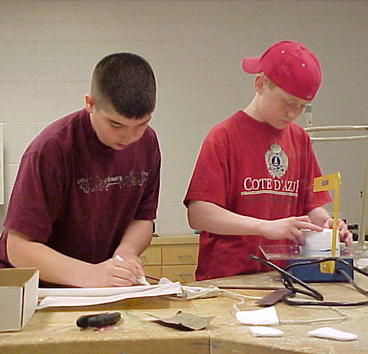
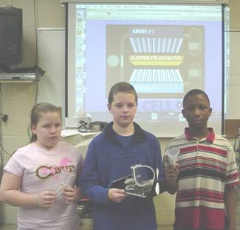
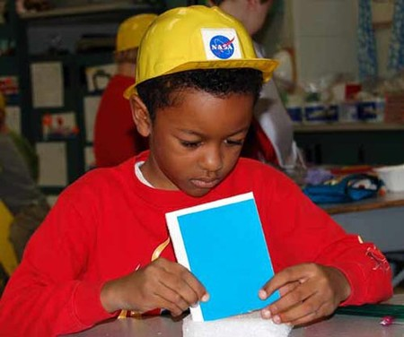



Foundations of Technology
Creativity and Brainstorming
Teacher Resource – Day 5
© 2016 International Technology and Engineering Educators Association
STEM Center for Teaching and Learning™
Foundations of Technology
Notes:
© International Technology Education Assoc
Slide #<number>
TITLE SLIDE
12/01/2009
STEMCenter for Teaching & Learning™ Engineering byDesign™

Slide 2

The BIG Idea
Big Idea:
Creativity is a major factor in creating inventions and developing innovations.
© 2016 International Technology and Engineering Educators Association
STEM Center for Teaching and Learning™
Foundations of Technology
Notes:
[Authors: Please include teacher notes appropriately.]
© International Technology Education Assoc
Slide #<number>
12/01/2009
STEMCenter for Teaching & Learning™ Engineering byDesign™

Slide 3

Creativity and Brainstorming
The purpose of this lesson is to incorporate creativity techniques when brainstorming.
These techniques will be practiced in small groups and recorded in the Engineering Design Journal.
© 2016 International Technology and Engineering Educators Association
STEM Center for Teaching and Learning™
Foundations of Technology
Notes:
[Authors: Please include teacher notes appropriately.]
© International Technology Education Assoc
Slide #<number>
12/01/2009
STEMCenter for Teaching & Learning™ Engineering byDesign™

Slide 4
Creativity
Researchers have tried to study how the minds of creative geniuses work, and there are strategies that we can use to become more creative thinkers.
  Most people can solve a given problem with an expected outcome.
  Creative people will solve a problem that has never been thought of or in a different way.
© 2016 International Technology and Engineering Educators Association
STEM Center for Teaching and Learning™
Foundations of Technology
Notes:
[Authors: Please include teacher notes appropriately.]
© International Technology Education Assoc
Slide #<number>
12/01/2009
STEMCenter for Teaching & Learning™ Engineering byDesign™

Slide 5

Creativity
Creativity is what leads to new and better ideas, innovations, and inventions.
Creativity simply is the ability to think differently and to question what
currently exists.
© 2016 International Technology and Engineering Educators Association
STEM Center for Teaching and Learning™
Foundations of Technology
Notes:
[Authors: Please include teacher notes appropriately.]
© International Technology Education Assoc
Slide #<number>
12/01/2009
STEMCenter for Teaching & Learning™ Engineering byDesign™

Slide 6
Creativity
Examples:
  In 1899 the director of the U.S. Patent office suggested that the government close the office because everything that could be invented had been.
  Chester Carlson invented xerography in 1938. At the time, people said carbon paper was the best way to copy things, and no one wanted to buy a copier.
© 2013 International Technology and Engineering Educators Association
STEMCenter for Teaching and Learning™
Foundations of Technology
Notes:
[Authors: Please include teacher notes appropriately.]
© International Technology Education Assoc
Slide #<number>
12/01/2009
STEMCenter for Teaching & Learning™ Engineering byDesign™

Slide 7

Brainstorming
A process used to collect ideas that will later be used to solve a problem.
Brainstorming should be done without regard for feasibility.
Brainstorming should occur
as a group with a specific
purpose.
© 2016 International Technology and Engineering Educators Association
STEM Center for Teaching and Learning™
Foundations of Technology
Notes:
[Authors: Please include teacher notes appropriately.]
© International Technology Education Assoc
Slide #<number>
12/01/2009
STEMCenter for Teaching & Learning™ Engineering byDesign™

Slide 8

Brainstorming
Rules for Brainstorming:
  One conversation at a time.
  Stay focused.
  Encourage wild ideas.
  Defer judgment.
  Build on the ideas of others.
© 2016 International Technology and Engineering Educators Association
STEM Center for Teaching and Learning™
Foundations of Technology
Notes:
[Authors: Please include teacher notes appropriately.]
© International Technology Education Assoc
Slide #<number>
12/01/2009
STEMCenter for Teaching & Learning™ Engineering byDesign™

Slide 9

Brainstorming
Criticism of Others:
  Try not to judge ideas immediately, allow them to be recorded.
  Build on wild ideas.
  Do not criticize an idea.
  Do not provide negative comments.
© 2016 International Technology and Engineering Educators Association
STEM Center for Teaching and Learning™
Foundations of Technology
Notes:
[Authors: Please include teacher notes appropriately.]
© International Technology Education Assoc
Slide #<number>
12/01/2009
STEMCenter for Teaching & Learning™ Engineering byDesign™

Slide 10

Brainstorming
Encourage All Ideas:
  All ideas should be recorded regardless of feasibility and humor.
  The best ideas are often the most off-the-wall.
  Be creative – you are only limited by your imagination.
© 2016 International Technology and Engineering Educators Association
STEM Center for Teaching and Learning™
Foundations of Technology
Notes:
[Authors: Please include teacher notes appropriately.]
© International Technology Education Assoc
Slide #<number>
12/01/2009
STEMCenter for Teaching & Learning™ Engineering byDesign™

Slide 11

Brainstorming
Everyone Should Participate:
  Focus on the “Big Idea” of the lesson/activity.
  Allow everyone to participate and share ideas.
  Listen to each group member.
  Stay focused on the topic.
© 2016 International Technology and Engineering Educators Association
STEM Center for Teaching and Learning™
Foundations of Technology
Notes:
[Authors: Please include teacher notes appropriately.]
© International Technology Education Assoc
Slide #<number>
12/01/2009
STEMCenter for Teaching & Learning™ Engineering byDesign™

Slide 12
Creativity Techniques
There are several techniques we can use to help us become more creative problem solvers.
We will briefly discuss three techniques for creativity.
  Mind-Mapping
  The da Vinci Method
  Inventive problem solving
© 2016 International Technology and Engineering Educators Association
STEM Center for Teaching and Learning™
Foundations of Technology
Notes:
[Authors: Please include teacher notes appropriately.]
© International Technology Education Assoc
Slide #<number>
12/01/2009
STEMCenter for Teaching & Learning™ Engineering byDesign™

Slide 13
Mind Mapping
The human brain is very different from a computer.
A computer works in a linear fashion, and the brain works associatively as well as linearly – by comparing, integrating, and synthesizing information.
Every single word and idea has numerous links attaching it to other ideas and concepts.
© 2016 International Technology and Engineering Educators Association
STEM Center for Teaching and Learning™
Foundations of Technology
Notes:
[Authors: Please include teacher notes appropriately.]
© International Technology Education Assoc
Slide #<number>
12/01/2009
STEMCenter for Teaching & Learning™ Engineering byDesign™

Slide 14
Mind Mapping
Mind Maps are an effective method of note-taking and useful for generating ideas by association.
To make a mind map, one starts in the center of the page with the main idea, and works outward in all directions, producing a growing and organized structure composed of key words and key images.
© 2016 International Technology and Engineering Educators Association
STEM Center for Teaching and Learning™
Foundations of Technology
Notes:
[Authors: Please include teacher notes appropriately.]
© International Technology Education Assoc
Slide #<number>
12/01/2009
STEMCenter for Teaching & Learning™ Engineering byDesign™

Slide 15
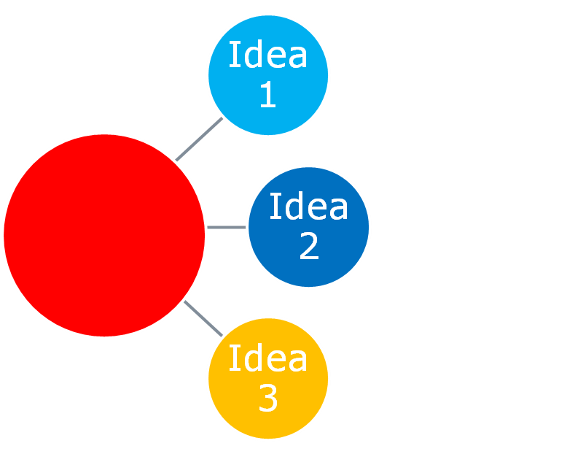
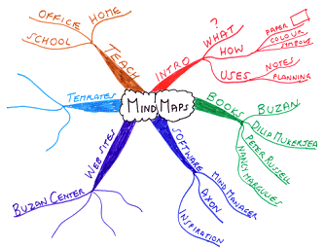
Mind Mapping
Main Idea
© 2016 International Technology and Engineering Educators Association
STEM Center for Teaching and Learning™
Foundations of Technology
Notes:
[Authors: Please include teacher notes appropriately.]
© International Technology Education Assoc
Slide #<number>
12/01/2009
STEMCenter for Teaching & Learning™ Engineering byDesign™

Slide 16
Mind Mapping
The creative potential of a mind map is during a brainstorming session.
Start with the basic problem at the center, and generate associations and ideas as you branch out.
By presenting your thoughts and perceptions in a spatial manner and by using color and pictures, a better overview can be gained and new connections can be made visible.
© 2016 International Technology and Engineering Educators Association
STEM Center for Teaching and Learning™
Foundations of Technology
Notes:
[Authors: Please include teacher notes appropriately.]
© International Technology Education Assoc
Slide #<number>
12/01/2009
STEMCenter for Teaching & Learning™ Engineering byDesign™

Slide 17
The Leonardo da Vinci Method
Leonardo da Vinci often came up with creative paintings by categorizing and listing variations of an idea or concept.
He would then mix and match different variations to create original ideas.
© 2016 International Technology and Engineering Educators Association
STEM Center for Teaching and Learning™
Foundations of Technology
Notes:
[Authors: Please include teacher notes appropriately.]
© International Technology Education Assoc
Slide #<number>
12/01/2009
STEMCenter for Teaching & Learning™ Engineering byDesign™

Slide 18
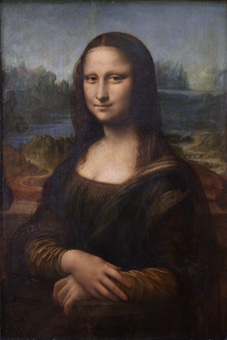
The Leonardo da Vinci Method
For example, the Mona Lisa was created by categorizing physical qualities of women.
Under each quality, da Vinci
listed several different
possibilities and attributes.
He then randomly selected these
traits to create the
famous painting.
© 2016 International Technology and Engineering Educators Association
STEM Center for Teaching and Learning™
Foundations of Technology
Notes:
[Authors: Please include teacher notes appropriately.]
© International Technology Education Assoc
Slide #<number>
12/01/2009
STEMCenter for Teaching & Learning™ Engineering byDesign™

Slide 19
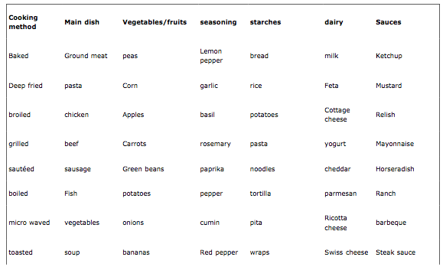
The Leonardo da Vinci Method
The below graphic uses cooking as an example. Each category can be mixed to create new ideas.
© 2016 International Technology and Engineering Educators Association
STEM Center for Teaching and Learning™
Foundations of Technology
Notes:
[Authors: Please include teacher notes appropriately.]
© International Technology Education Assoc
Slide #<number>
12/01/2009
STEMCenter for Teaching & Learning™ Engineering byDesign™

Slide 20
Inventive Problem Solving
Inventive problem solving is a process that involves dialectic logic or the art of investigating.
The theory is based on the premise that all technological systems evolve towards an ideal state.
© 2016 International Technology and Engineering Educators Association
STEM Center for Teaching and Learning™
Foundations of Technology
Notes:
[Authors: Please include teacher notes appropriately.]
© International Technology Education Assoc
Slide #<number>
12/01/2009
STEMCenter for Teaching & Learning™ Engineering byDesign™

Slide 21
Inventive Problem Solving
Steps Involved in the Inventive Problem-Solving Method:
  Once the problem is defined, the group should describe the ideal state and classify the desired solution.
  The group will then brainstorm “contradictions” or gaps between the existing technology and the ideal state.
© 2016 International Technology and Engineering Educators Association
STEM Center for Teaching and Learning™
Foundations of Technology
Notes:
[Authors: Please include teacher notes appropriately.]
© International Technology Education Assoc
Slide #<number>
12/01/2009
STEMCenter for Teaching & Learning™ Engineering byDesign™

Slide 22
Inventive Problem Solving
Steps Involved in the Inventive Problem-Solving Method:
  Those “contradictions” are then studied and compared to similar products. The evolution of those products is studied, specifically identifying how the product evolved beyond the “contradiction.”
  Potential solutions are categorized and evaluated. The best ideas are then applied to develop the ideal state of the technology.
© 2016 International Technology and Engineering Educators Association
STEM Center for Teaching and Learning™
Foundations of Technology
Notes:
[Authors: Please include teacher notes appropriately.]
© International Technology Education Assoc
Slide #<number>
12/01/2009
STEMCenter for Teaching & Learning™ Engineering byDesign™

